Slide 1


Road Damage Identification based on Traffic Big Data for Coastal City Disaster Relief
Cheng WANG PhD, Professor
Fujian Key Lab on Sensing and Computing for Smart City
Xiamen University， China
May 31， 2017

Slide 2
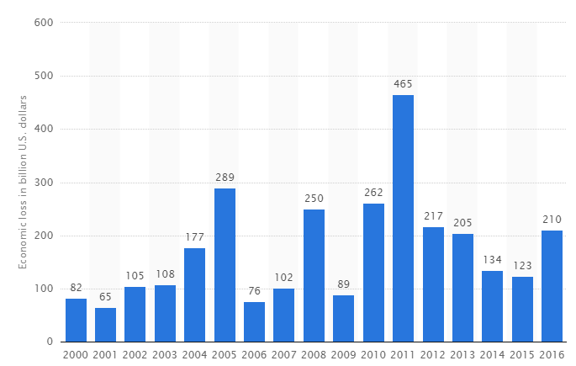
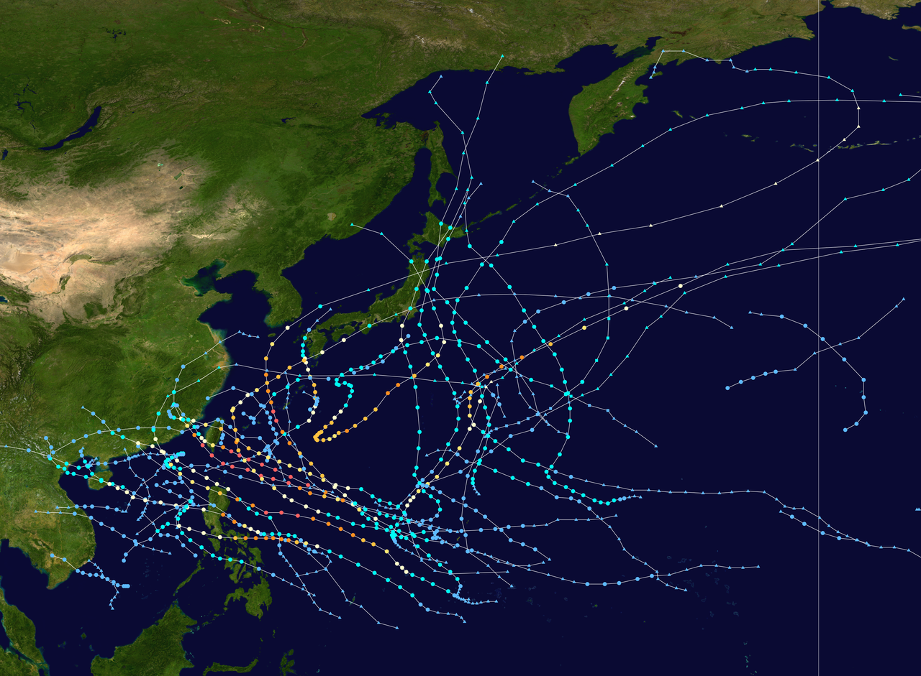
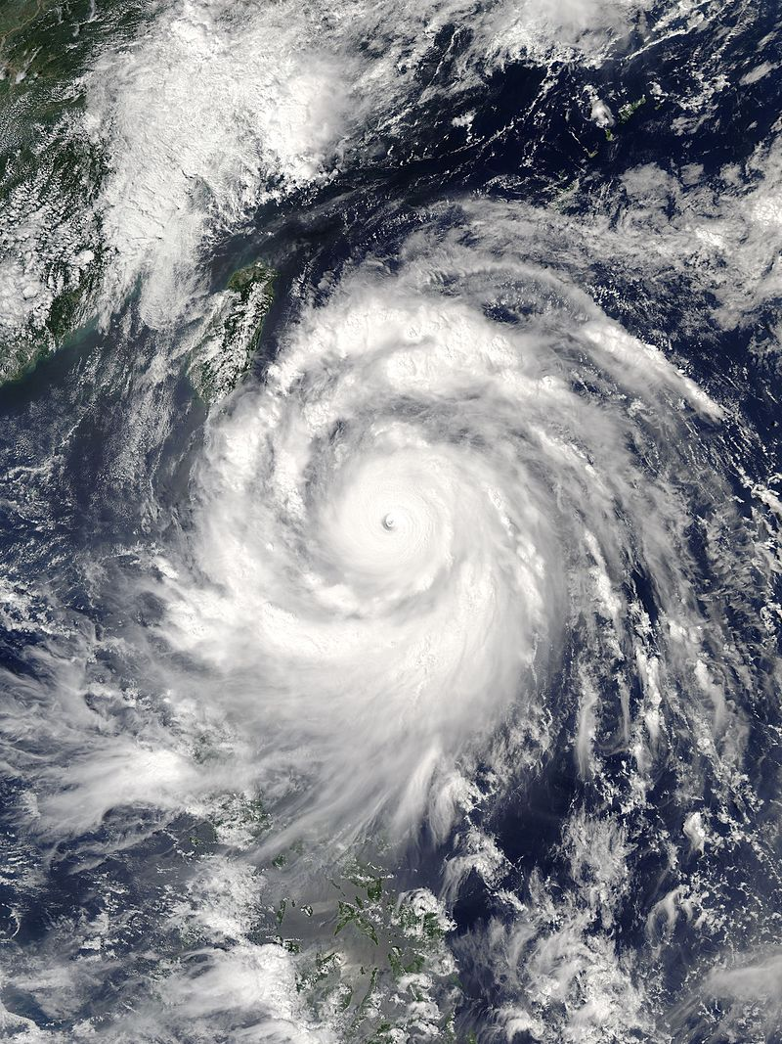
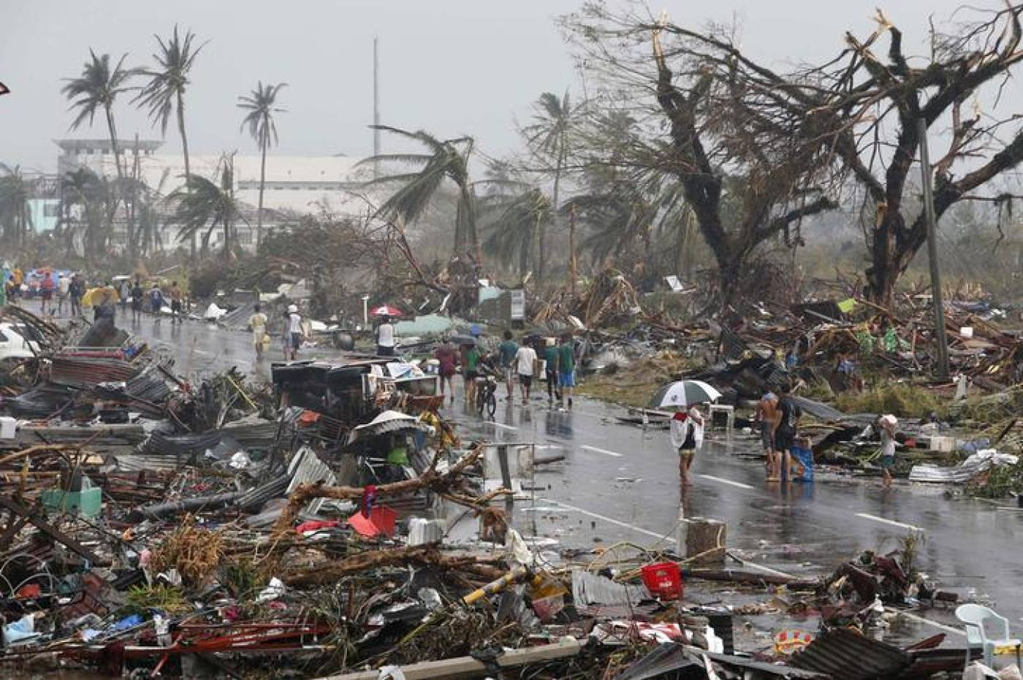
Natural Disasters in Costal Cities
Nature disasters in costal cities
Typhoon, earthquake, tsunami, etc.
Great loss: life, infrastructure, economy
Economic loss from natural disaster (in billion U.S. dollars)
Source: www.statista.com
tropical cyclones in the 2016 Pacific typhoon season

Slide 3
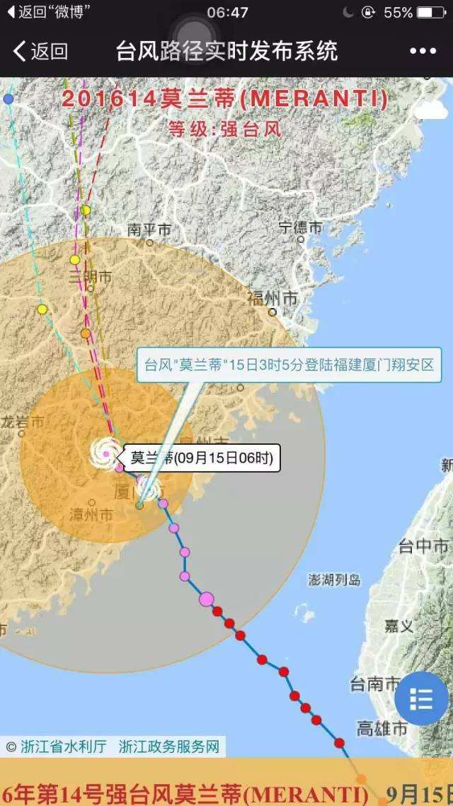
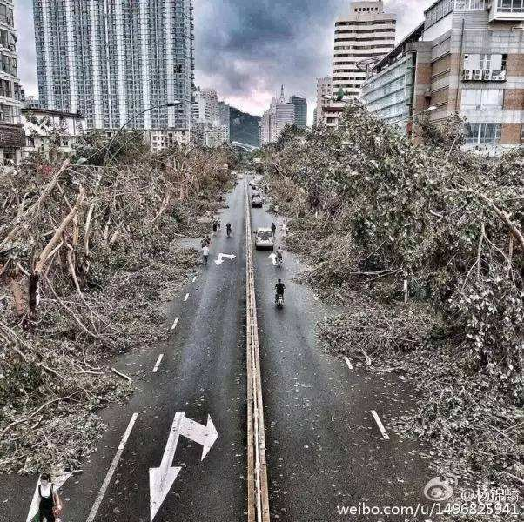
“World’s strongest storm of 2016” Typhoon Meranti Sep. 2016
Formed | September 8, 2016
Dissipated | September 17, 2016
(Extratropical after September 16)
Highest winds | 10-minute sustained:220 km/h (140 mph) 1-minute sustained:305 km/h (190 mph)
Lowest pressure | 890 hPa (mbar); 26.28 inHg
Fatalities | 30 confirmed, 15 missing
Damage | $2.63 billion (2016 USD)
Areas affected | Philippines, Taiwan, China, Korean Peninsula

Slide 4
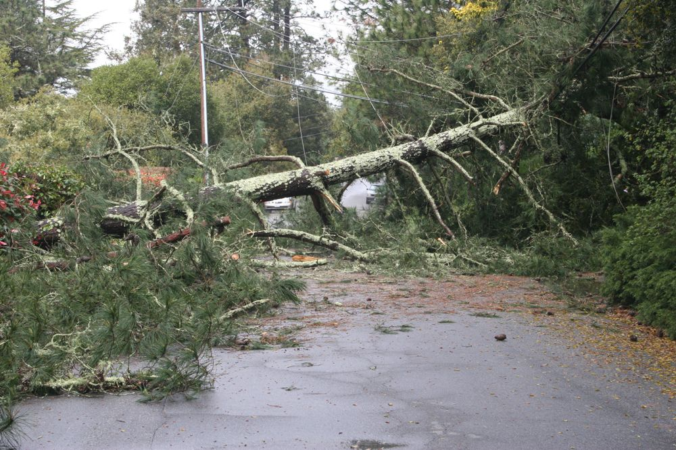
Road Damages in Natural Disasters
Disaster relief
Prevention, Response, Recovery¹
Effective response: save life, reduce loss
Immediate restoration of road damage: key to search and rescue
Existing methods
Human scanner: labor intensive, delayed, dangerous
Traffic camera: damaged, blind areas

Slide 5
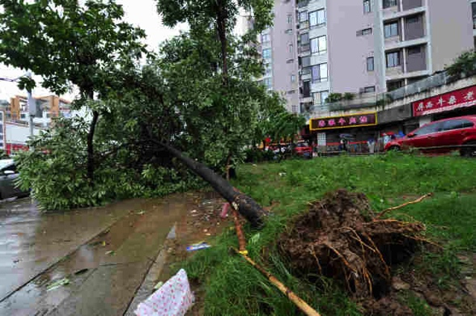
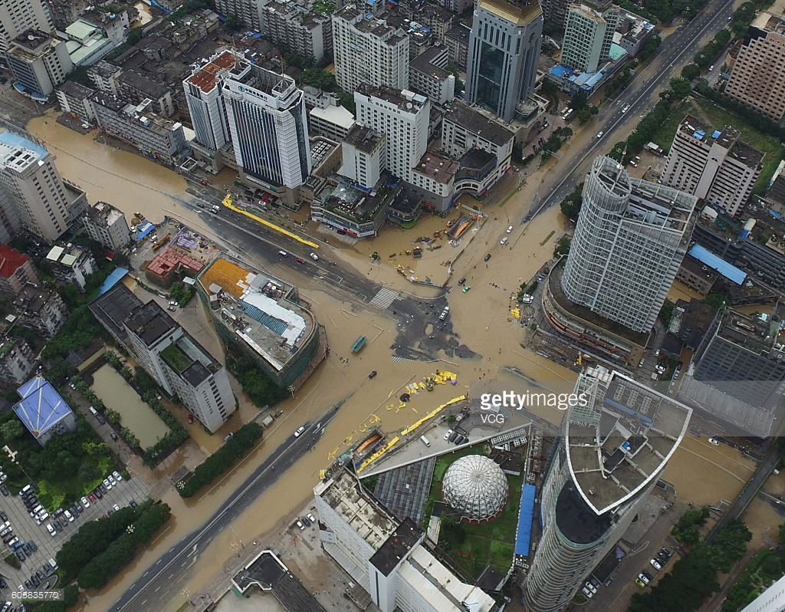
Objectives
Develop a real-time, low-cost method to identify road damage for urban disaster response.
Detection: when and where
Recognition: fallen trees, ponding water, etc.

Slide 6
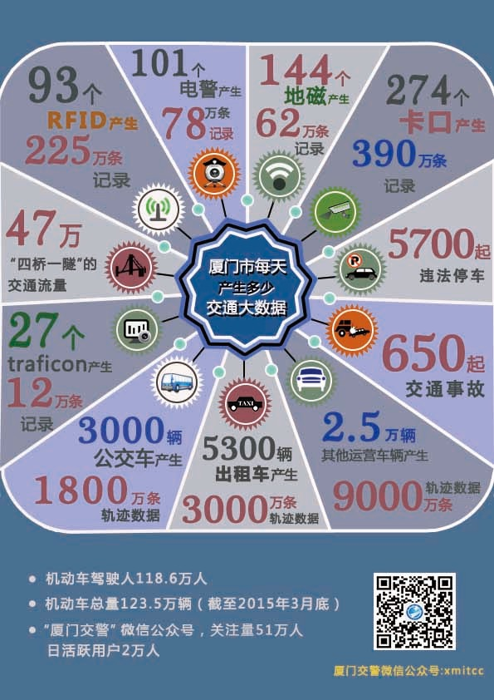
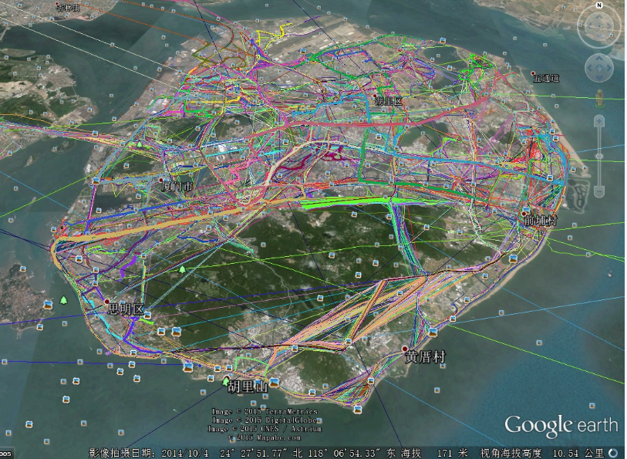
Traffic Big Data ( Xiamen City, China)
GPS Trajectories of 3000 buses on Oct. 4, 2014, Xiamen

Slide 7
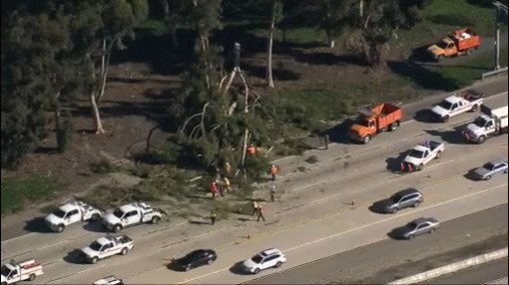
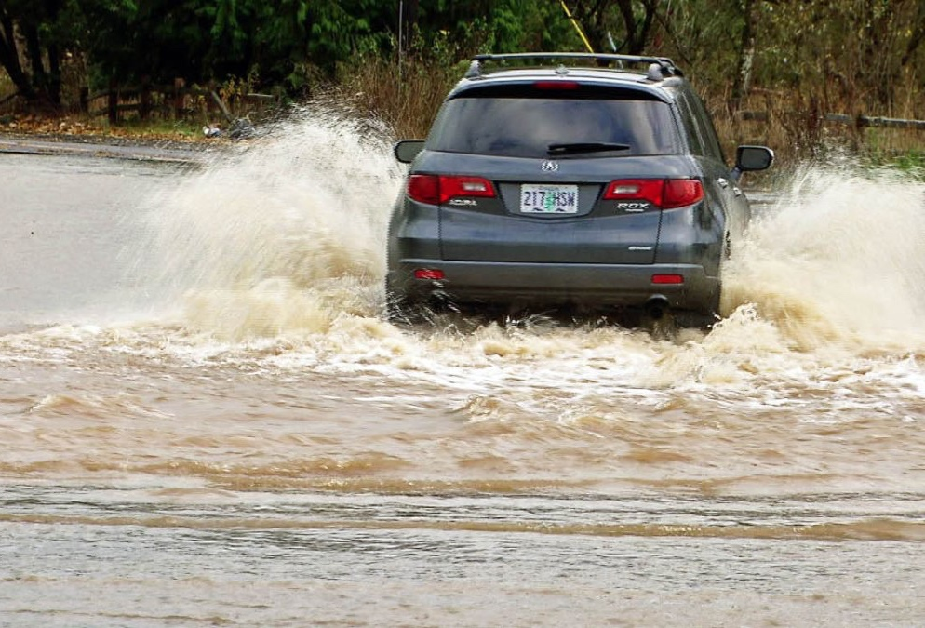
Vehicle-as-a-Sensor (VaaS)
GPS trajectories of taxis: city-wide, long-term
1 records per minute in Xiamen, 3 years, 3000 taxis
Vehicle trajectory patterns change in damaged roads
fallen trees → lane blocked
ponding water → dangerous road condition
}
Abnormal Vehicle Trajectory

Slide 8
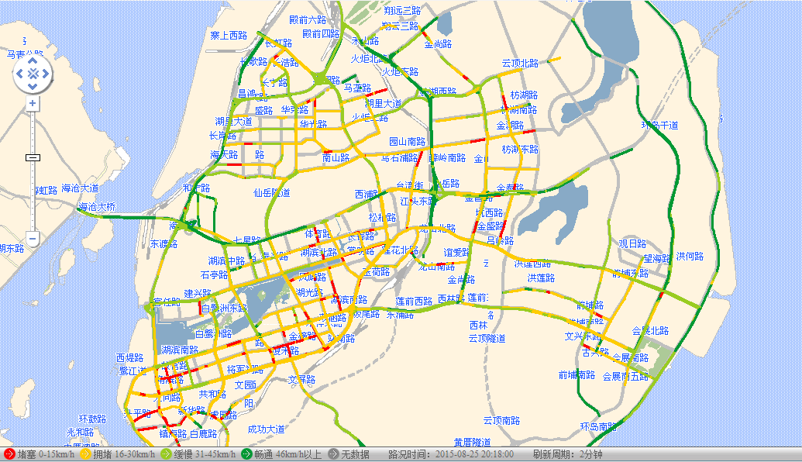
Traffic Congestion Identification based on Taxi GPS Trajectories

Slide 9
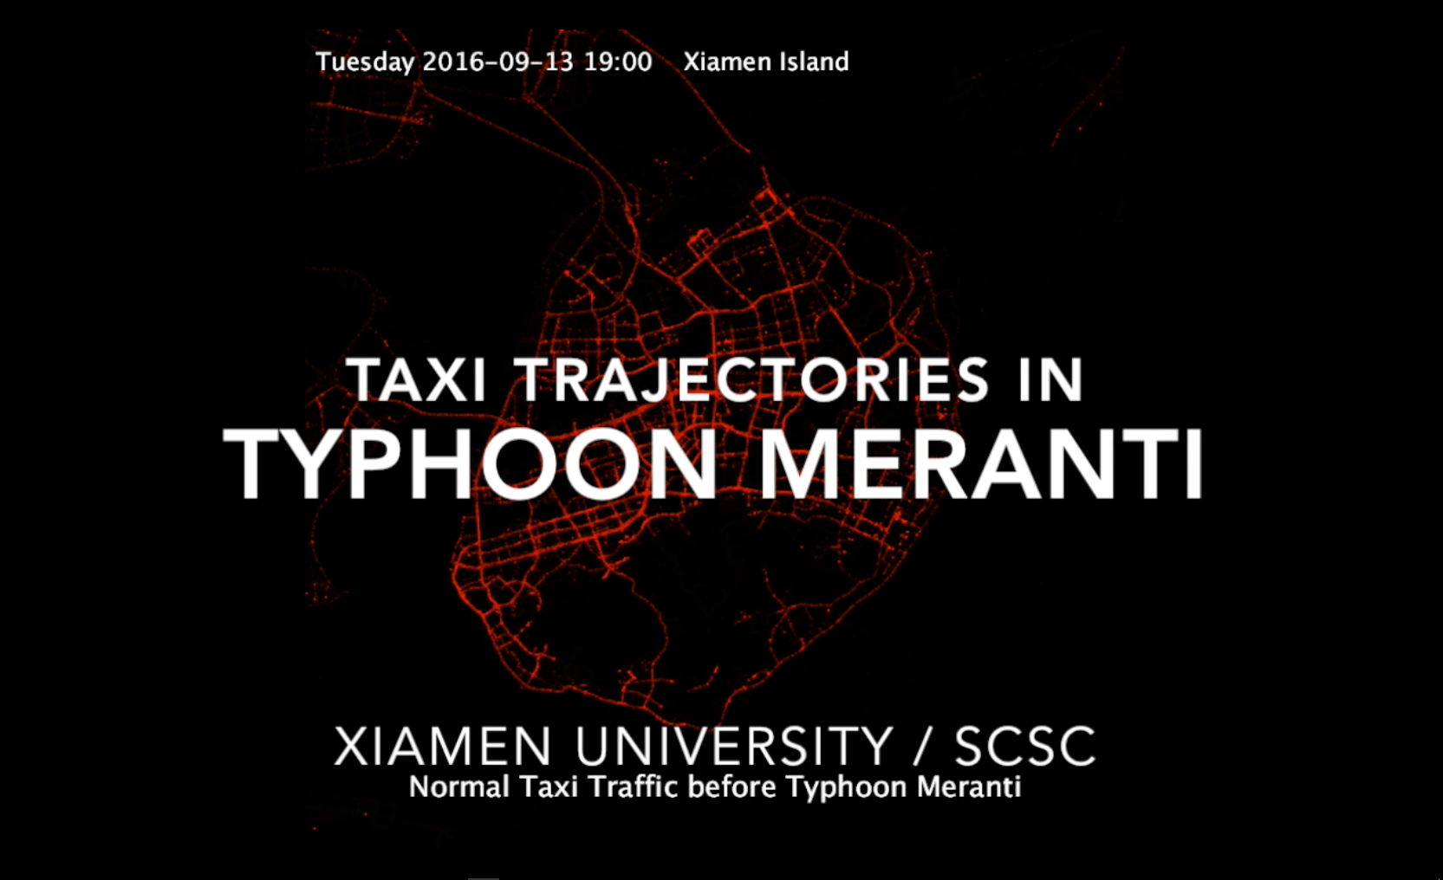
Traffic Big Data @ Typhoon Meranti Sep. 2016

Slide 10
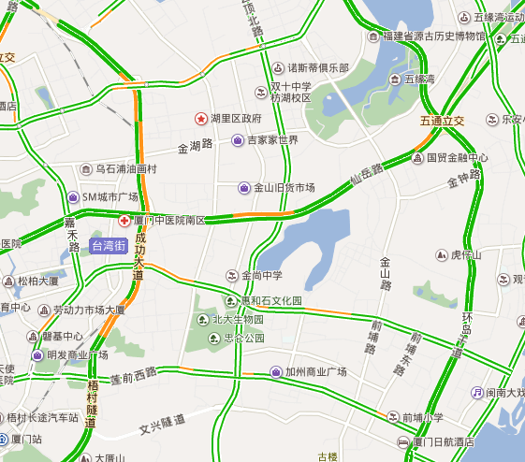
Detecting Road Damages
Road traffic pattern modeling
Digital map → road segmentation
Historical vehicle trajectory → traffic aggregation
Abnormal traffic detection
Hypothesis-test-based method
Real-time analysis: 10 minute time slot
Anomaly aggregation
Adjacent time slots
Neighboring road segments
}
Gaussian Mixture Model
for Road Traffic
}

Slide 11
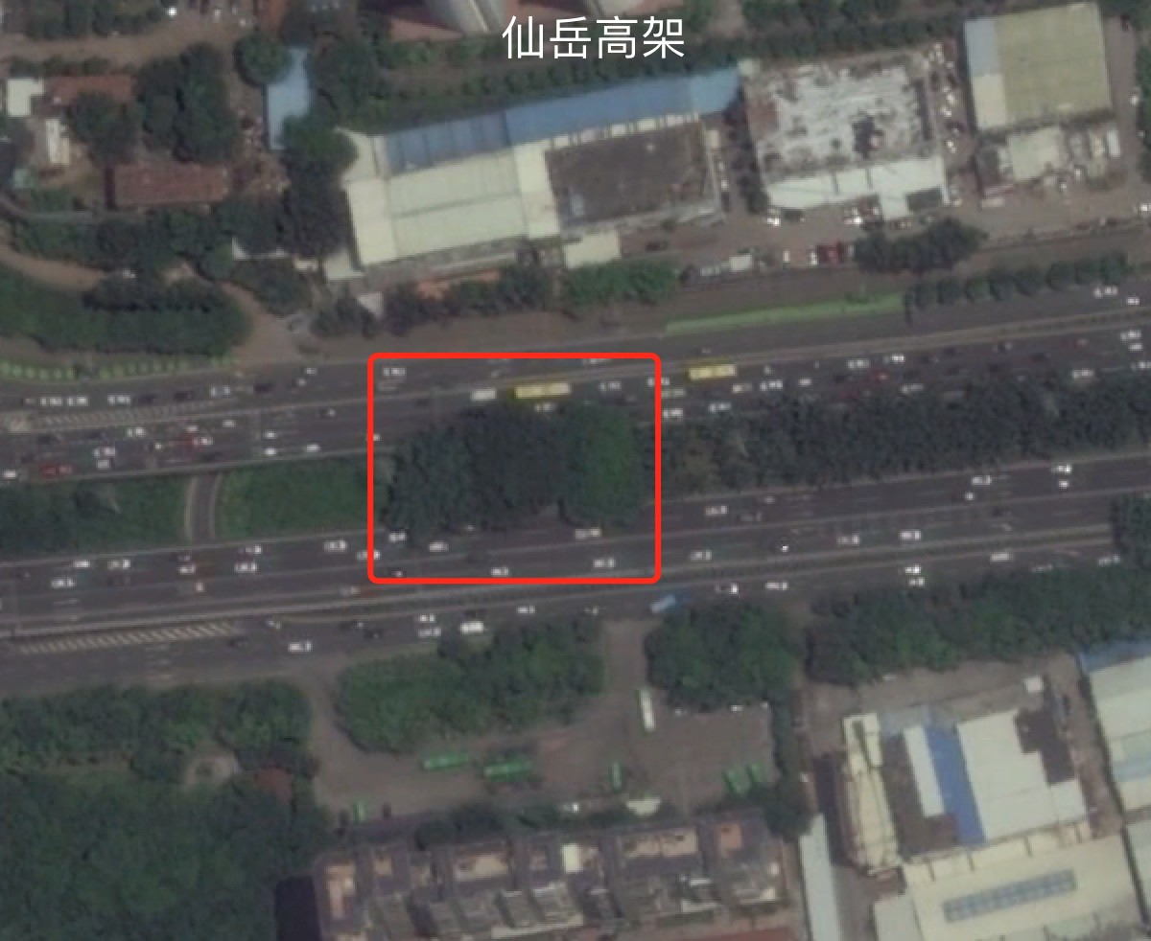
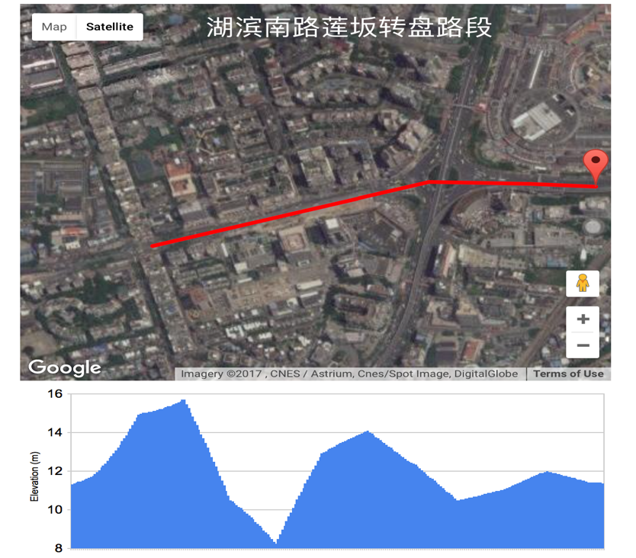
False Alarm Removal and Recognizing Road Damage Types
Irrelevant anomaly removal
Accidents → sync from traffic police information center
Road damage type inference
High tree coverage on the road → fallen trees (from satellite image)
Low road elevation → ponding water (from digital elevation map)
tree coverage
road elevation

Slide 12
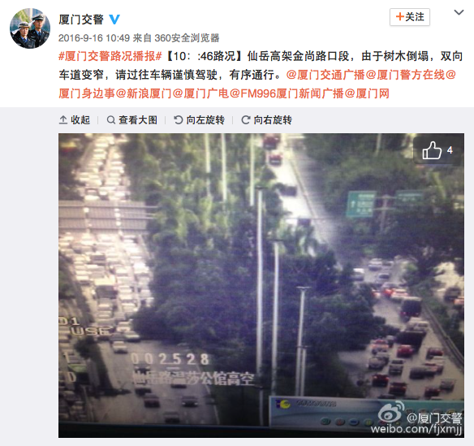
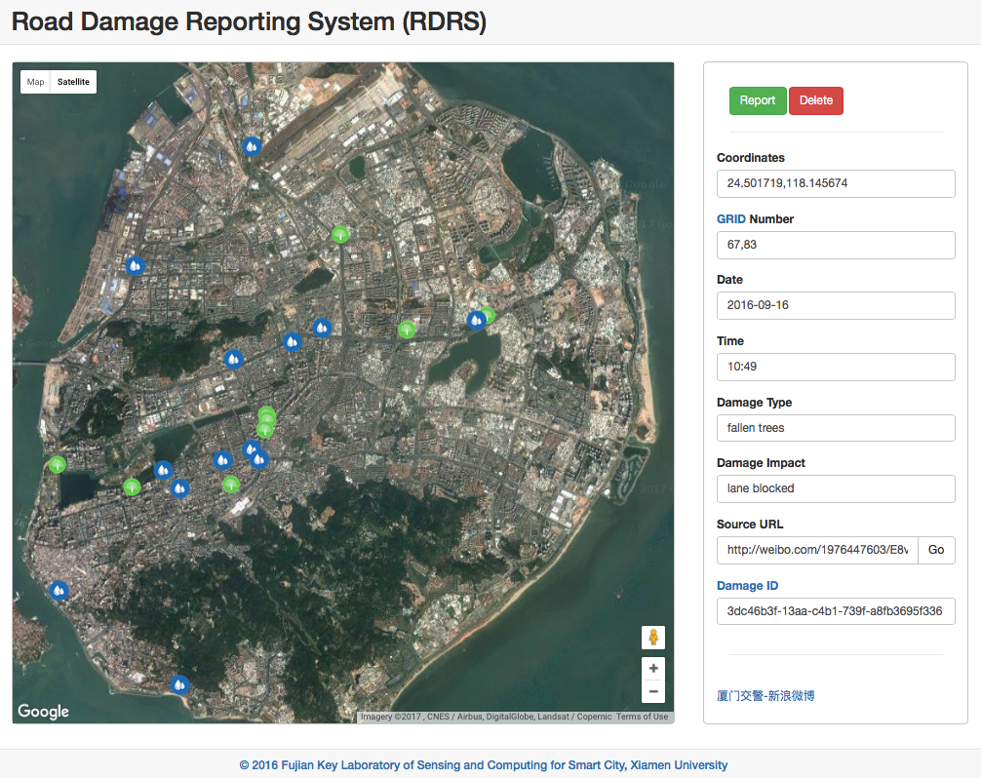
Performance Evaluation
News updates from road authority
Crowd-souring damage reporting system ( Weibo )
News updates (tweets)
Road damage reporting system

Slide 13
Summary
The concept of Vehicle-as-a-Sensor (VaaS) is introduced for disaster relief
Taxi Trajectory big data can be used for real-time, low-cost detection and recognition of road damages, when, where, which type( fallen trees, ponding water, etc.）
Proposed method has been tested with real data in Typhoon Meranti
Future Work
Better traffic modeling and anomaly detecting algorithms
Fine-grained road damage characterization: more types, etc.
Evaluations on more historical events and other cities

Slide 14

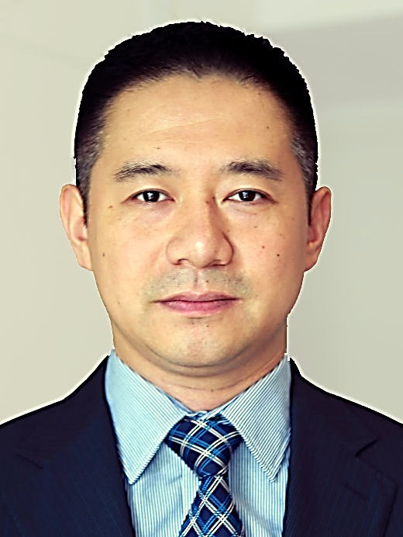
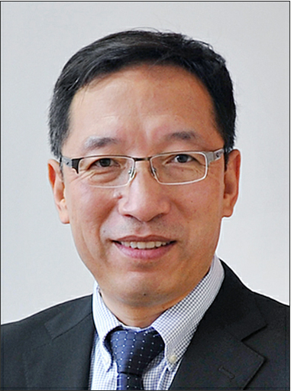

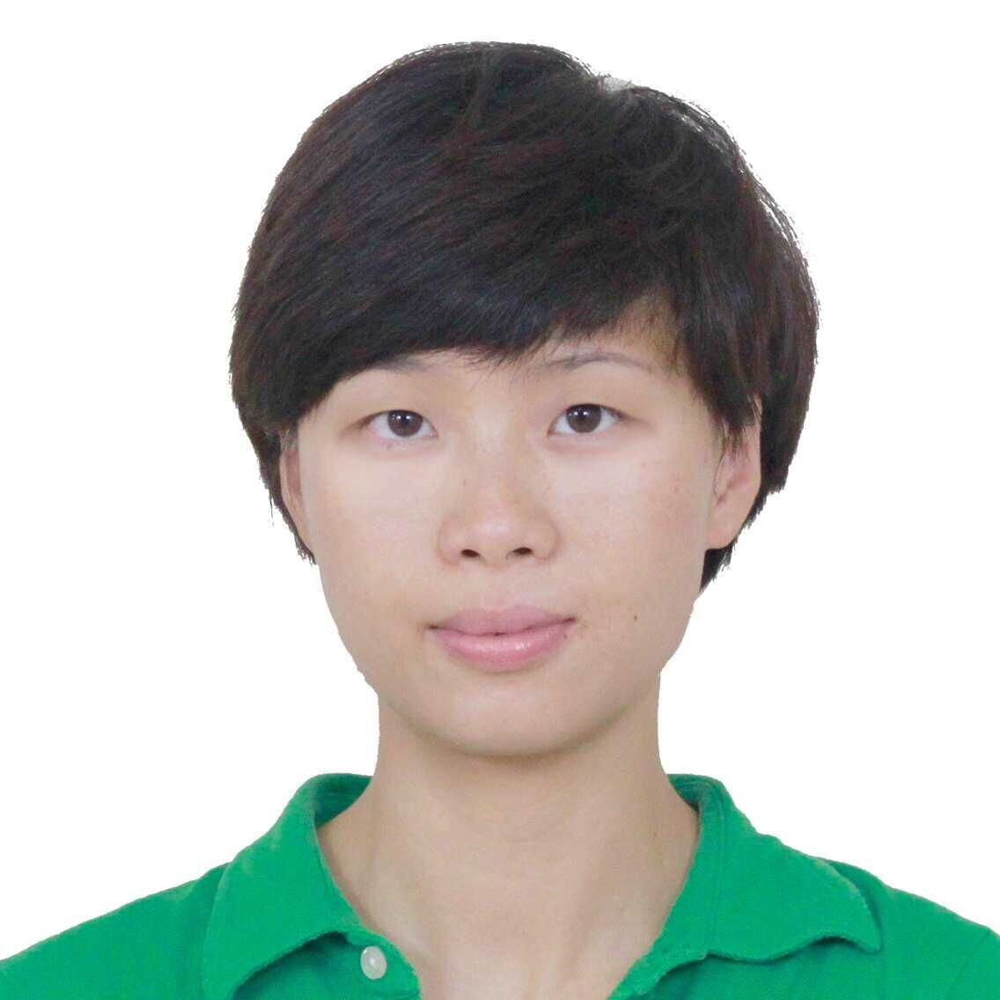
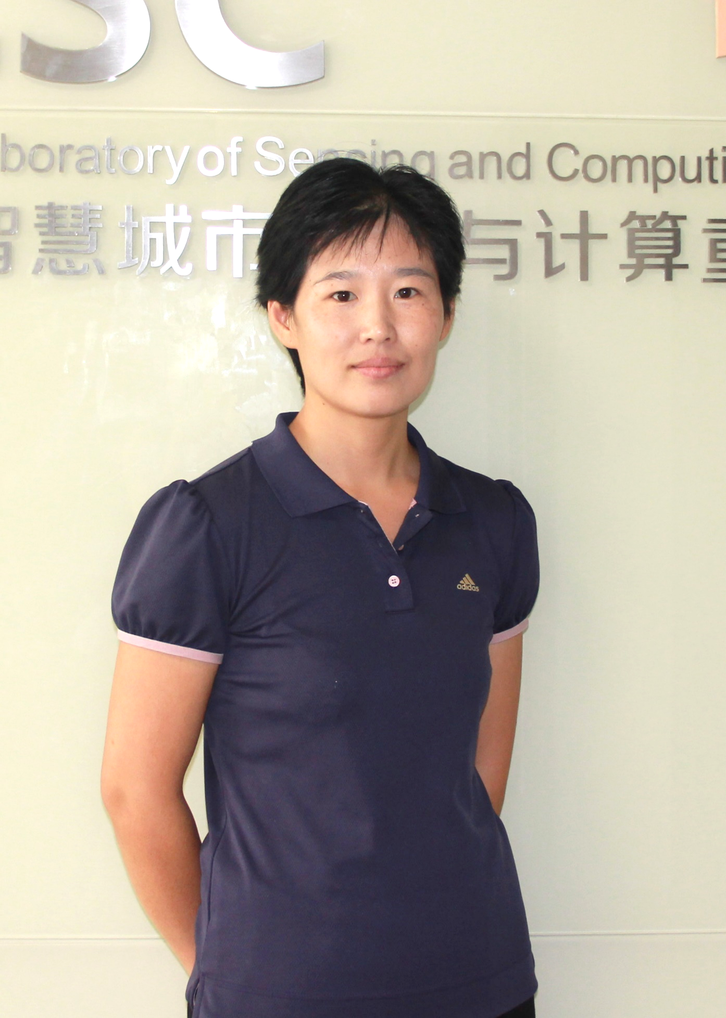




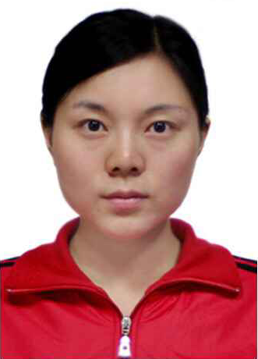
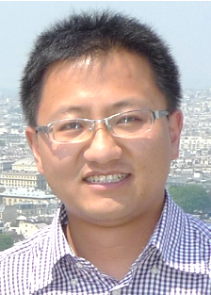
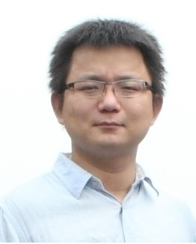
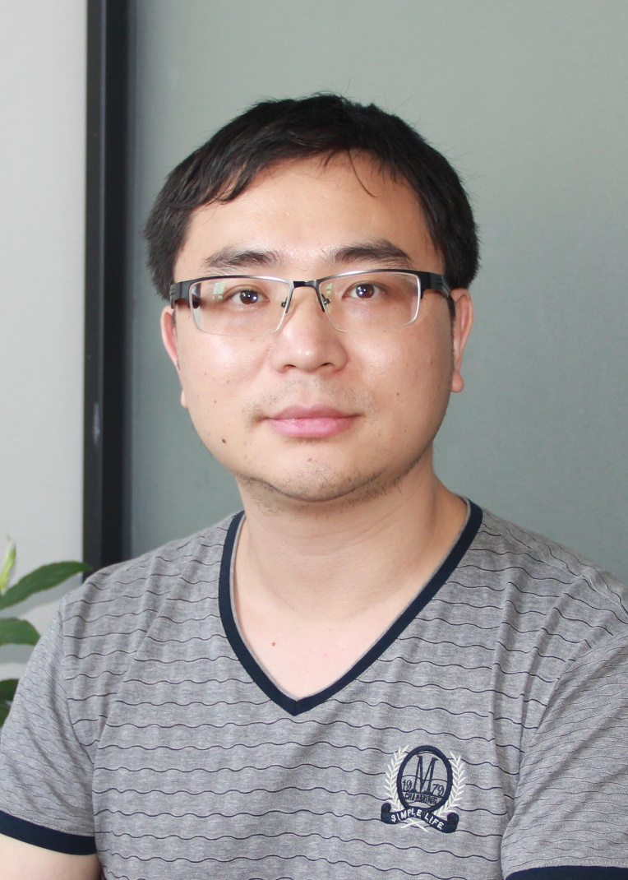

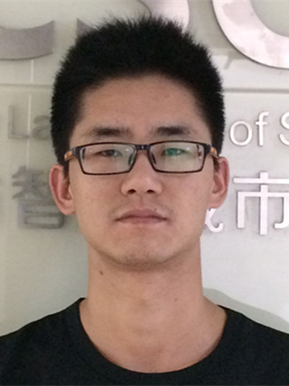

Fujian Key Laboratory of Sensing and Computing for Smart City
Urban Geo Sensing & Computing
Urban Network Video Surveillance
Urban Data Mining
Urban Environment & Behavior Analysis
Urban Geo Sensing & Computing
Cheng WANG，PhD
Professor
Jonathan LI，PhD
Professor
Ming CHENG, PhD
Associate Professor
Chenglu WEN, PhD
Associate Professor
Liujuan CAO, PhD
Assistant Professor
Yu ZANG, PhD
Assistant Professor
Zhemin ZHANG, PhD
Assistant Professor
Zhenlong XIAO, PhD, Assistant Professor
Longbiao CHEN, PhD
Assistant Professor
Yinping CHEN
PhD
Senior Engineer
Xiaoliang FAN
PhD
Research Scientist
Wentao YANG
Research Scientist
Hong JIA
Manager
& Engineer
Kecheng ZHANG
Survey Engineer
Feng CHEN,
PhD
Research Scientist

Slide 15

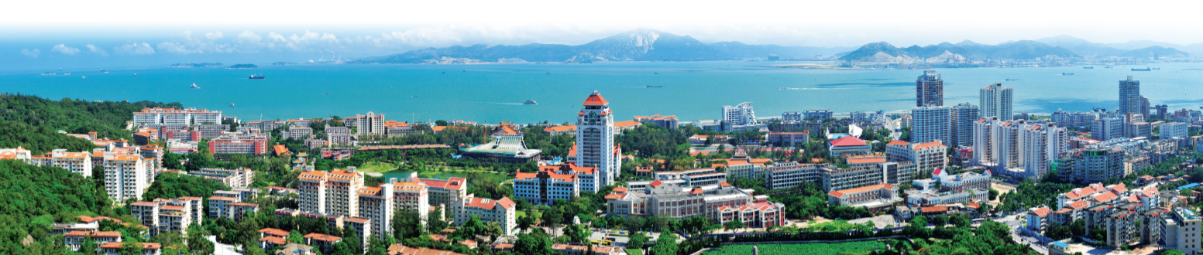
Thanks for your attention!
cwang@xmu.edu.cn
http://scsc.xmu.edu.cn
Xiamen University, China

